Slide 1

CityGrid LA Hackathon

Slide 2
the
team:
christopher truman
joe rozner
hana nesbitt
peter kovach

Slide 3


the
APIs:

Slide 4
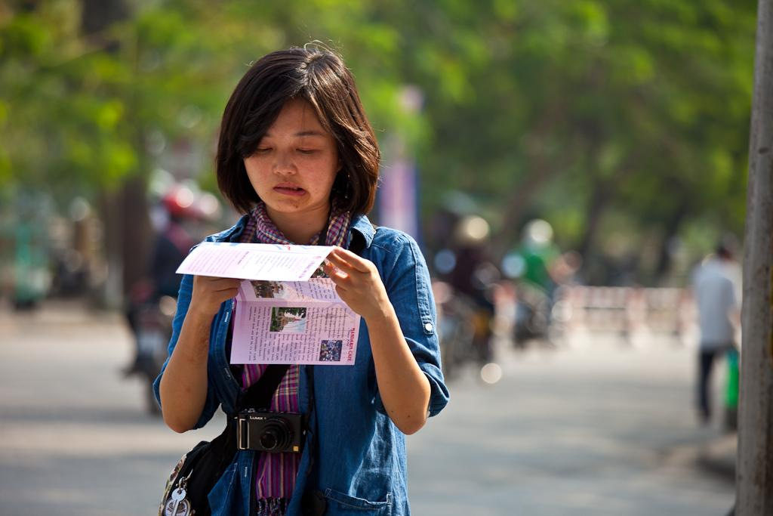

the problem:
- unknown place
- “what do you want" syndrome

Slide 5
the
solution:
hyper-local, GPS based
four simple results
friendly, clean design
in-app directions
visual inspiration

Slide 6
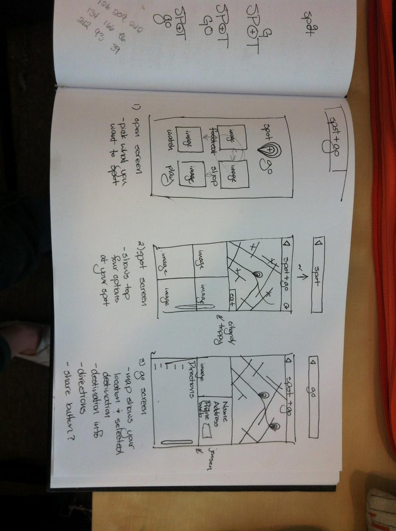
the
concept design:

Slide 7
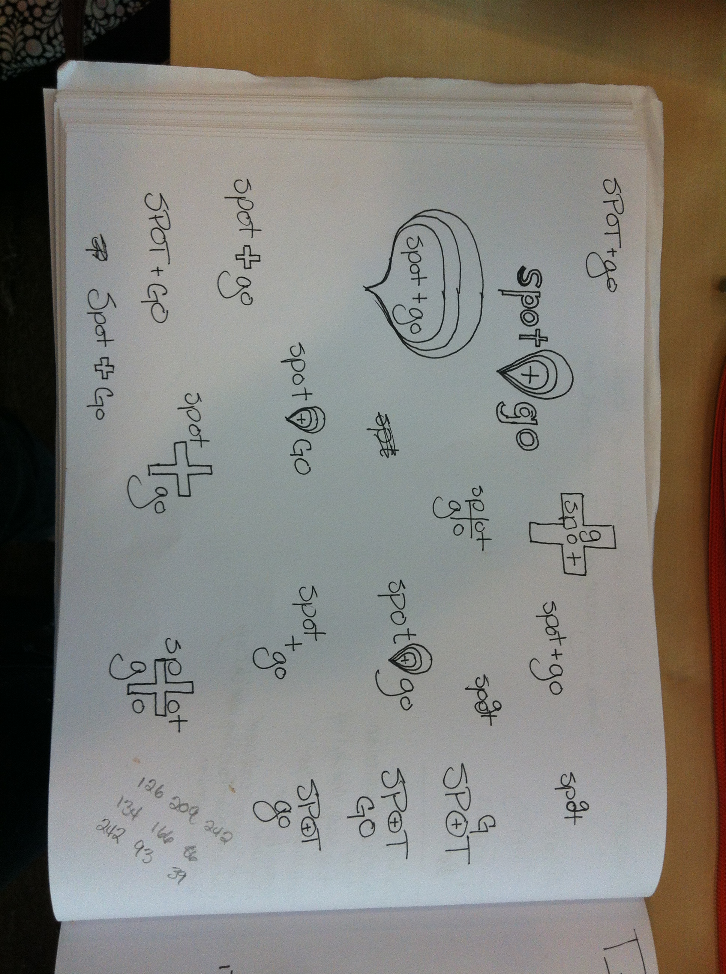

Slide 8

the
UI design:

Slide 9


Slide 10


the
developers:
Cocoa Touch
Sinatra

Slide 11
and now the
demo. . .

Slide 12
https://github.com/jstart/Spot-Go
http://bit.ly/IgubsK

